Slide 1
2014-10-14 Propulsion Update
Notes:
Explore why motors are so far from manufacturer

Slide 2
Summary
Completed testing new motors
Matched data
Have reached a “soft lock” of motor/prop

Slide 3
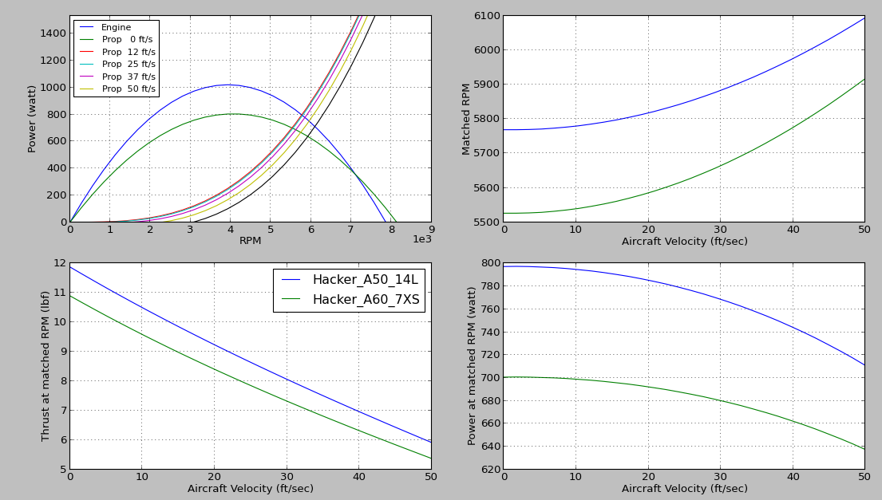

Best Prop & Motor Match
20x8 Prop - Hacker A50 14L
Static: 11.5-12lbs thrust

Slide 4
Summary Statistics
Continuous Power Draw: 940W
Static Thrust: 11.5-12lbf
Static Runtime: 4 minutes
Item | Stat
Power Draw | 940W Continuous
Static Thrust | 11.5-12lbf (15-20% increase)
Static Runtime (worst case) | 4 minutes

Slide 5
Going Forward
Motor and propeller are in a “soft lock”
state
Remaining efforts
  ESC testing (low effort)
  Limiter testing (can’t do yet)
  Continued prop/motor searching (low effort)
In “locked state” – propulsion efforts will be moved to other teams

Slide 6
BACKUP

Slide 7

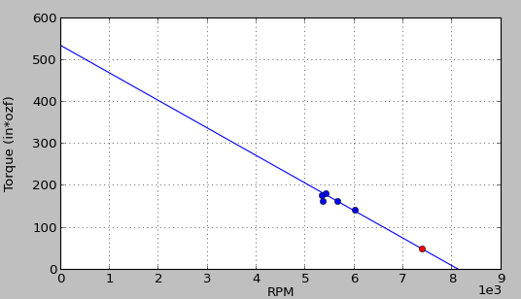
Hacker A60 7XS

Slide 8
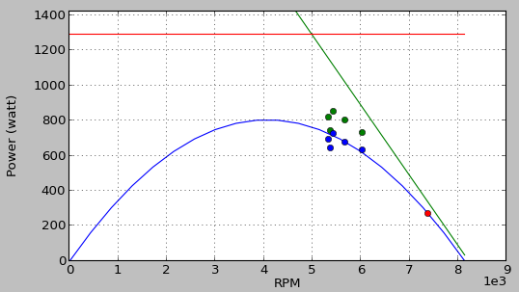
Hacker A60 7XS

Slide 9
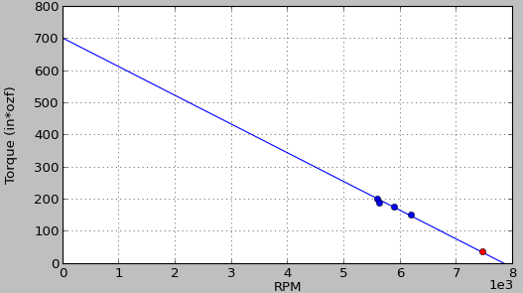
Hacker A50 14L

Slide 10
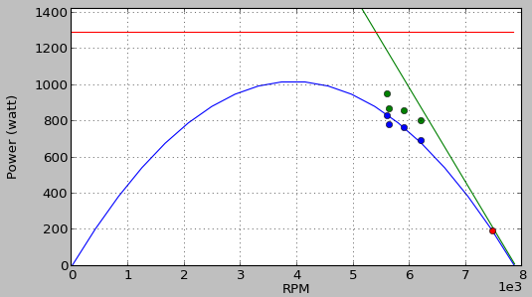
Hacker A50 14L

Slide 11
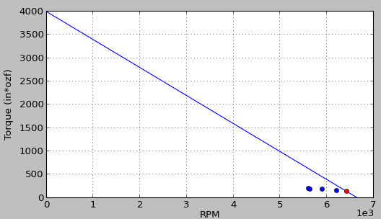
Hacker A50 14L – Pre Match

Slide 12
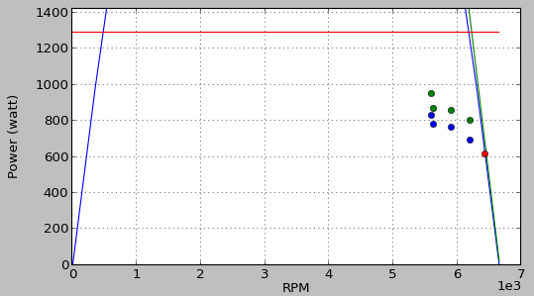
Hacker A50 14L – Pre Match

